Slide 1
PHP get and post

Slide 2
Get and Post Methods in PHP
PHP provides two methods through which a client (browser) can send information to the server. These methods are given below, and discussed in detail:
GET method
POST method

Slide 3
Get and Post Methods in PHP(contd.)
Get and Post methods are the HTTP request methods used inside the <form> tag to send form data to the server.
HTTP protocol enables the communication between the client and the server where a browser can be the client, and an application running on a computer system that hosts your website can be the server.

Slide 4
GET
The GET method is used to submit the HTML form data. This data is collected by the predefined $_GET variable for processing.
The information sent from an HTM form using the GET method is visible to everyone in the browser's address bar, which means that all the variable names and their values will be displayed in the URL. Therefore, the get method is not secured to send sensitive information.

Slide 5
POST
The POST method is also used to submit the HTML form data. But the data submitted by this method is collected by the predefined superglobal variable $_POST instead of $_GET.
Unlike the GET method, it does not have a limit on the amount of information to be sent. The information sent from an HTML form using the POST method is not visible to anyone.

Slide 6
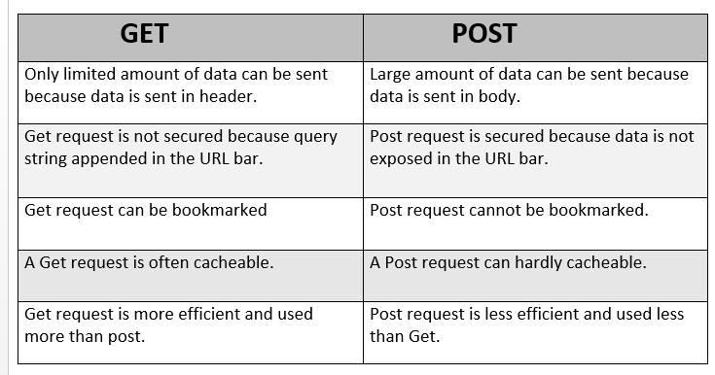

Slide 7
$_REQUEST variable
The $_REQUEST variable is a superglobal variable, which can hold the content of both $_GET and $_POST variable.
In other words, the PHP $_REQUEST variable is used to collect the form data sent by either GET or POST methods.

Slide 8
Example 1

Slide 9
Create a file get.php
<html>
<body>
<form action = "gettest.php" method = "GET">
Username: <input type = "text" name = "username" /> <br>
Blood Group: <input type = "text" name = "bloodgroup" /> <br>
<input type = "submit" />
</form>
</body>
</html>

Slide 10
Create a file gettest.php
<html>
<body>
Welcome <?php echo $_GET["username"]; ?> </br>
Your blood group is: <?php echo $_GET["bloodgroup"]; ?>
</body>
</html>

Slide 11
Execute get.php
OUTPUT:
Welcome Mamta Your blood group is: A+

Slide 12
Example 2

Slide 13
Create a file post.php
<html>
<body>
<form action = "posttest.php" method = "post">
Username: <input type = "text" name = "username" /> <br>
Blood Group: <input type = "text" name = "bloodgroup" /> <br>
<input type = "submit" />
</form>
</body>
</html>

Slide 14
Create a file posttest.php
<html>
<body>
Welcome <?php echo $_POST["username"]; ?> </br>
Your blood group is: <?php echo $_POST["bloodgroup"]; ?>
</body>
</html>

Slide 15
Execute post.php
OUTPUT:
Welcome mamta Your blood group is: A+

Slide 16
Example 3

Slide 17
Create a file get-method.php
<!DOCTYPE html>
<html lang="en">
<head>
<title>Example of PHP GET method</title>
</head>
<body>
<?php
if(isset($_GET["name"])){
echo "<p>Hi, " . $_GET["name"] . "</p>";
}
?>
<form method="get" action="<?php echo $_SERVER["PHP_SELF"];?>">
<label for="inputName">Name:</label>
<input type="text" name="name" id="inputName">
<input type="submit" value="Submit">
</form>
</body>

Slide 18
Execute get-method.php
OUTPUT:
Hi, mamta

Slide 19
Example 4

Slide 20
Create a file post-method.php
<!DOCTYPE html>
<html lang="en">
<head>
<title>Example of PHP POST method</title>
</head>
<body>
<?php
if(isset($_POST["name"])){
echo "<p>Hi, " . $_POST["name"] . "</p>";
}
?>
<form method="post" action="<?php echo $_SERVER["PHP_SELF"];?>">
<label for="inputName">Name:</label>
<input type="text" name="name" id="inputName">
<input type="submit" value="Submit">
</form>
</body>

Slide 21
Execute post-method.php
OUTPUT:
Hi, mamta

